Slide 1


Hybrid Deep Learning Model for Real vs Fake PAN Card Detection

Slide 2
PROBLEM STATEMENT
Developing a hybrid model that combines a Convolutional Neural Network (CNN) for image classification and Optical Character Recognition (OCR) for text extraction from PAN card images.
Validating the extracted PAN number using regex to check its authenticity and format.
Fusing the CNN output and OCR-based text validation to classify PAN cards as real or fake.

Slide 3
KPI’S ACHIEVED TILL NOW
Collected a raw dataset of over 500 real PAN card images to support the model training and testing process.
Implemented and tested the pytesseract library for extraction of text from PAN card images.
Developed a validation system using regular expressions (regex) to verify the legitimacy of extracted PAN numbers based on standard formatting and validation rules.
Conducted an extensive literature review and evaluated multiple approaches for detecting real vs fake PAN cards, ultimately finalizing a unique and innovative methodology that combines text extraction, image analysis, and ML/DL techniques for classification.

Slide 4
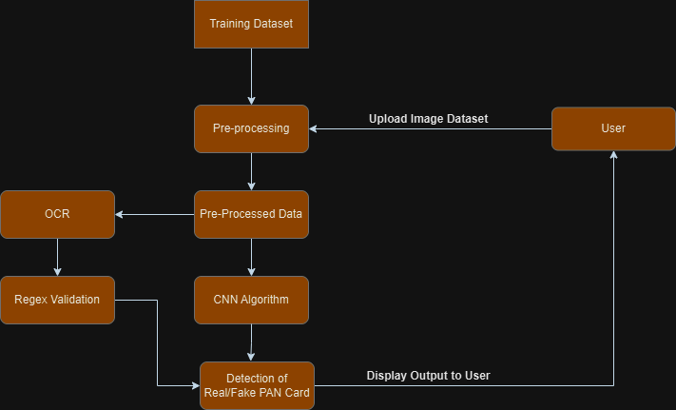

Slide 5
DATA COLLECTION AND PREPROCESSING
Collect a diverse dataset of PAN card images (real and fake).
Perform image preprocessing (resizing, augmentation, and data splitting) to enhance model generalization. Techniques like random rotations, flips, and noise addition can be used to simulate real-world conditions.

Slide 6
CUSTOM CNN ARCHITECTURE
Designing a custom CNN model tailored for our PAN card classification task. The model will consist of:
Convolutional Layers: For feature extraction from images.
Pooling Layers: To reduce spatial dimensions and retain important features.
Fully Connected Layers: For decision-making based on extracted features.
Output Layer: A sigmoid or softmax layer to classify images as "real" or "fake."

Slide 7
MODEL TRAINING
Split the dataset into training, validation, and test sets (70% training, 15% validation, 15% test).
Train the custom CNN model using the preprocessed real and fake PAN card dataset.
Utilize techniques like batch normalization and data augmentation to prevent overfitting.
Optimize the model using a suitable loss function and an optimizer.

Slide 8
OCR INTEGRATION AND TEXT EXTRACTION
Implement OCR to extract key text features from the PAN card (PAN number).
Use regex to validate the extracted PAN number against a standard pattern.

Slide 9
COMBINING IMAGE AND TEXT-BASED FEATURES
Merge the CNN classification output with the OCR + regex validation results.
Design a decision-making process (weighted average or probability) to combine both outputs and classify the PAN card as real or fake.

Slide 10
MODEL EVALUATION
Evaluate the performance of the custom CNN model using metrics like accuracy, precision, recall, and F1-score.
Extract the confidence score for each prediction to represent the model’s certainty about its classification (e.g., the probability that the card is real or fake).
Compare the results with those of pre-trained models like ResNet, MobileNet, EfficientNet to benchmark performance.

Slide 11
FINAL DEPLOYMENT
We can implement the trained model as an API to allow easy integration with external systems such as KYC processes, banking applications for real-time PAN card verification.

Slide 12
NEXT STEPS
Explore and implement Generative Adversarial Networks (GANs) to generate synthetic fake PAN card images for training.
Augment PAN Card Images to introduce variations in text fonts, backgrounds, and distortions.
Refine text extraction techniques to improve accuracy, especially with noisy, rotated or blurred images.
Apply advanced preprocessing techniques like resizing, noise reduction to prepare raw data for model training.

Slide 13
CHALLENGES
Difficulty in accurately extracting PAN numbers from rotated, noisy, or blurred images.
Ensuring the model generalizes well across a wide range of PAN card formats, fonts, and image variations from different sources.
Ensuring that the GAN generates realistic fake PAN cards that closely resemble genuine cards in terms of fonts, design, and other visual elements.

Slide 14
FUTURE SCOPE
Advanced Multi-Class Classification: Expand the model to classify different types of fraud, such as fake PAN cards due to altered fonts, mismatch in photo, or invalid PAN numbers, offering a more detailed fraud detection system.
Facial Comparison Between User Selfie and PAN Card Image: Implement facial recognition technology to compare the user’s live selfie with the photo on the PAN card.
Multi-Modal Authentication: Integrate multiple verification methods, combining visual features from CNNs, text validation through OCR, and external data sources like government databases for a more secure verification process.

Slide 15
THANK YOU

